Slide 1
LLM Architectures
Plaban Kumar Bhowmick
Department of AI
plaban@ai.iitkgp.ac.in

Slide 2
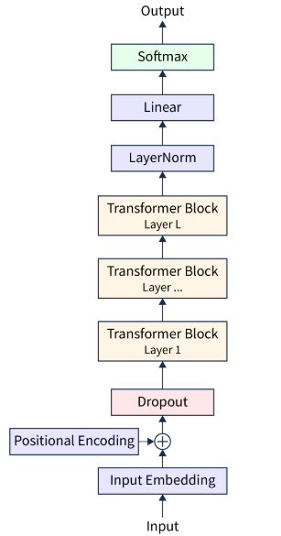
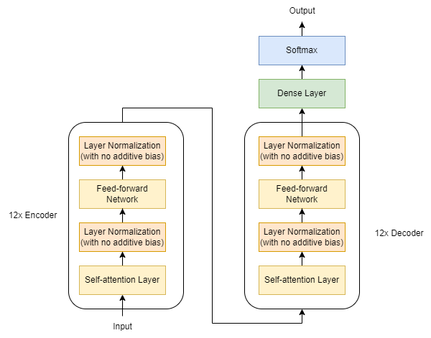
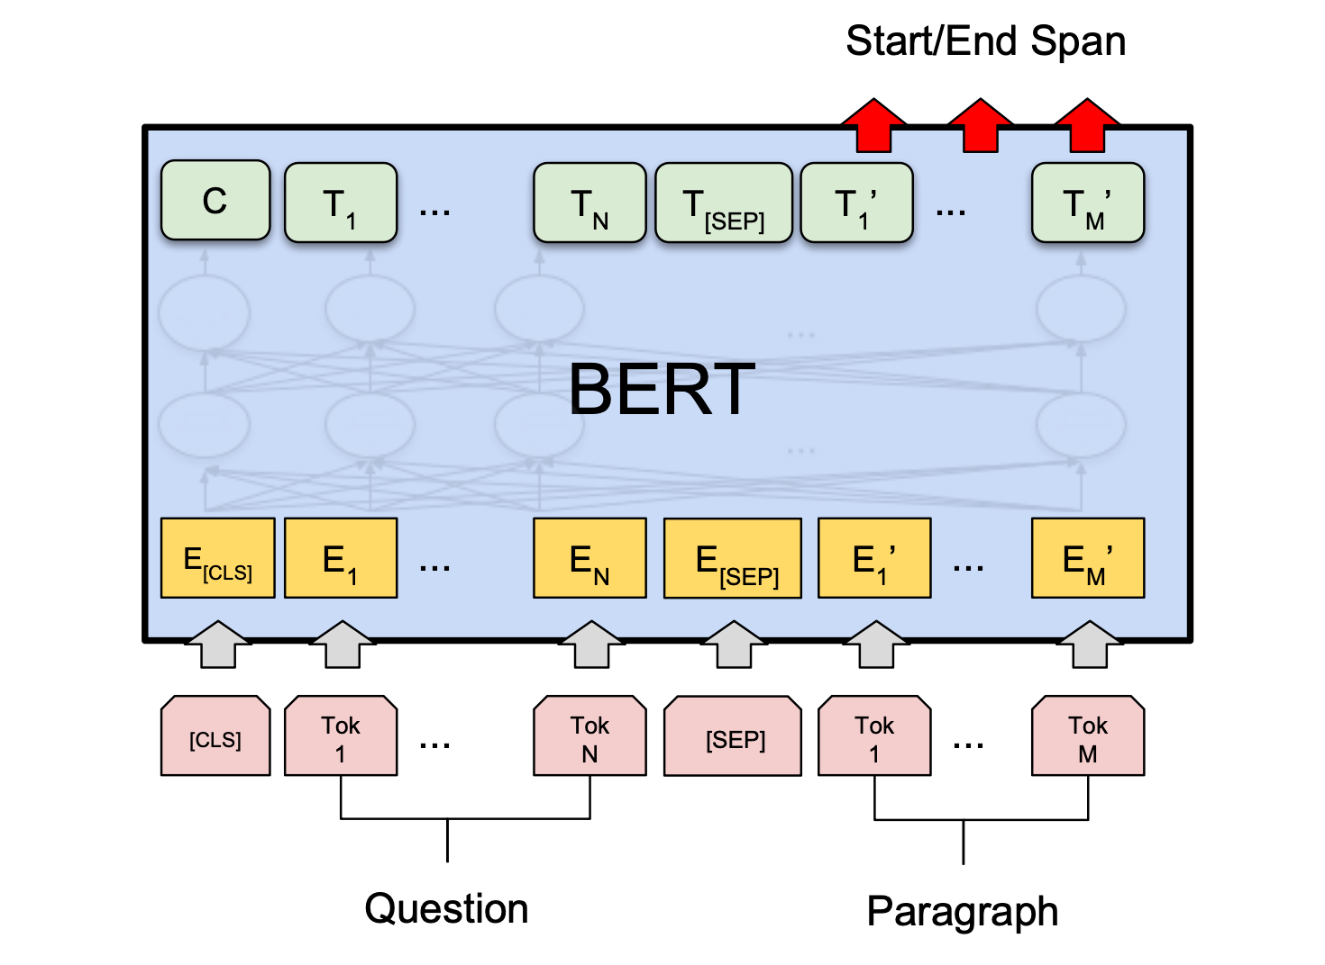
Transformer as Foundation of LLMs
Encoder Only
Encoder-Decoder
BERT
T5
Autoencoder Language Model
Multi-Task Learning
Decoder Only
GPT
Autoregressive Language Model

Slide 3
Autoregressive (AR) Language Model
Predict the most likely next token conditioned on previous tokens (prompt)
Predict longer text by repeated token prediction
Include previously predicted token in the prompt
Use <START> as the initial prompt

Slide 4
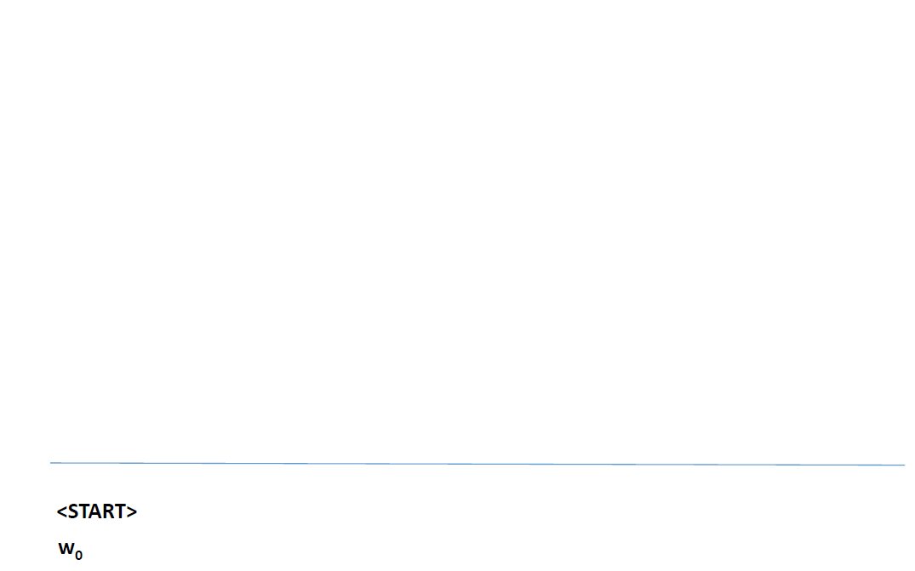
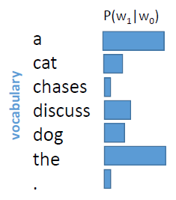
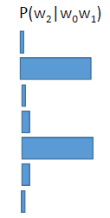
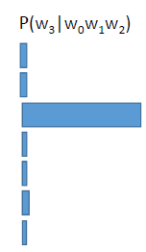
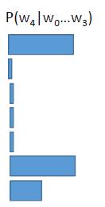
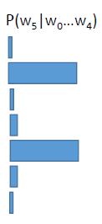
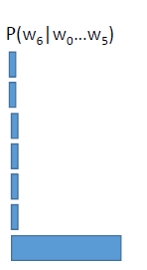






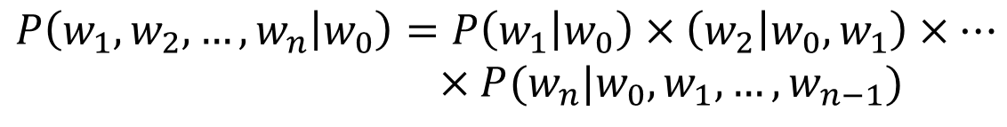
Autoregressive Language Model (ARLM)
$$P\left(w_{1}, w_{2}, …, w_{n} | w_{0}\right)=P\left(w_{1} | w_{0}\right)×\left(w_{2} | w_{0}, w_{1}\right)×…$$
$×P(w_{n}|w_{0}, w_{1}, …, w_{n−1})$

Slide 5
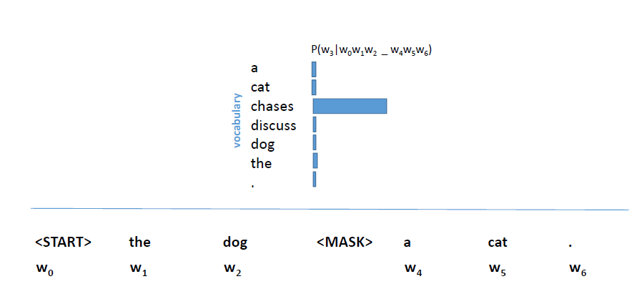
Auto Encoder Language Model (AELM)
$$P\left(w_{i} | w_{0}, w_{1}, …, w_{i−1}, w_{i+1}, …, w_{n}\right)$$
Masked Language Model

Slide 6
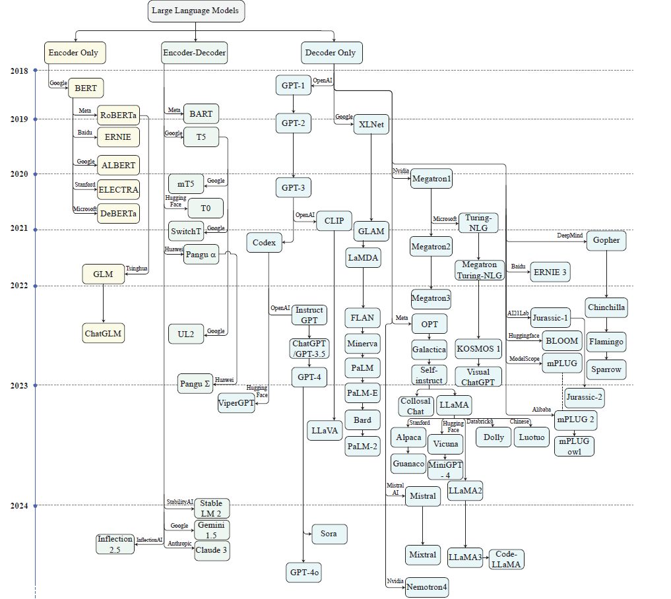
DeepSeek-V2
DeepSeek-V3
DeepSeek-R1

Slide 7
Encoder Only Architectures

Slide 8
BERT
Bidirectional
Encoder
Representation
through Transformers
Considers both left and right context
Used only the encoder block of Transformer
Derive rich representation as any other LM
Copy of the Transformer encoder block

Slide 9

Context Matters
Word2vec embeddings
NLP System
Embedding
Look up
Embedding
Look up
I ate a delicious apple today
Apple partners with Tata Group
for iPhone today
‘apple’ appears in different contexts; their embedding should be different
ELMo and BERT derives embedding of a token based on the context it appears in

Slide 10
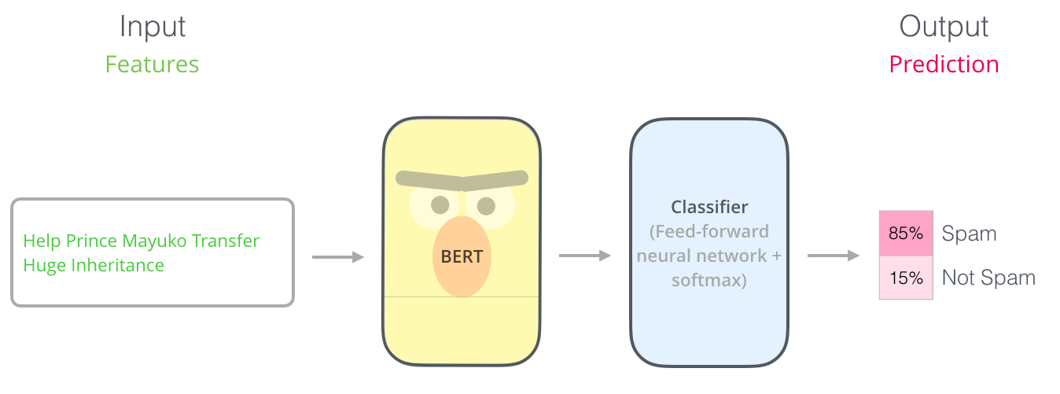
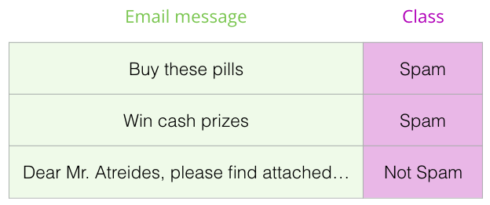
BERT: Transfer Learning Setting

Slide 11
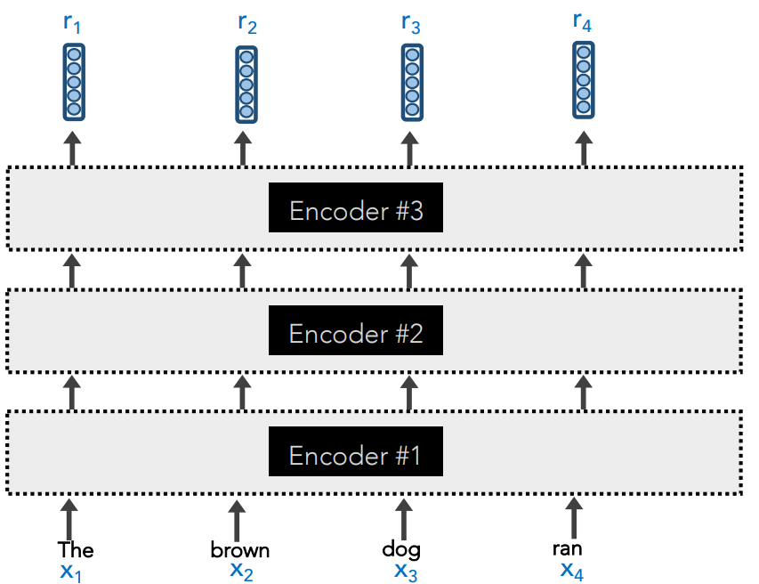
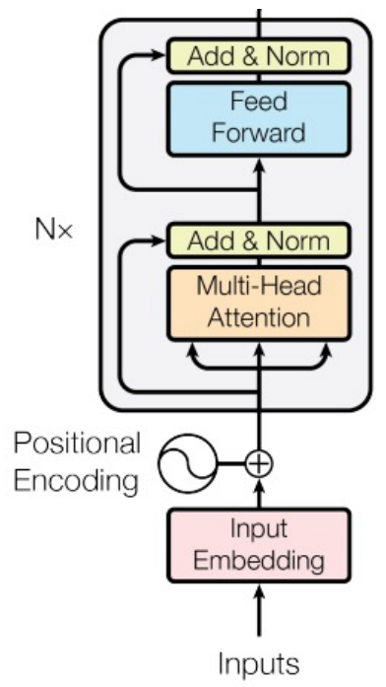
Copy of Transformer Encoder Block
With some modifications

Slide 12
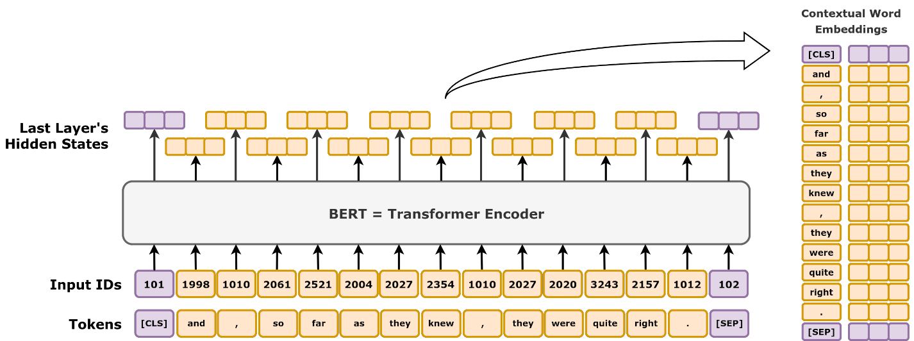
The BERT

Slide 13
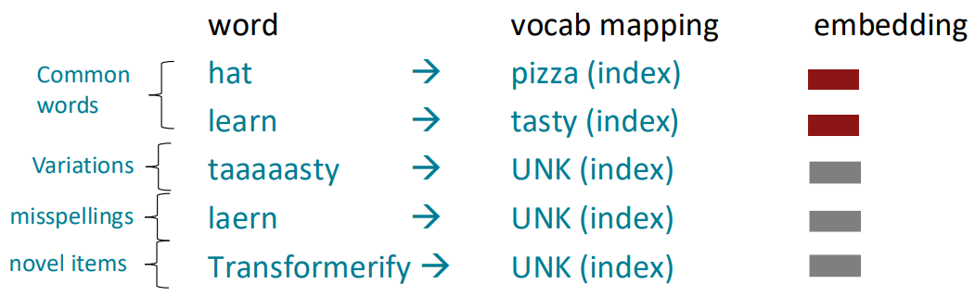
Input Tokens: Many Words are Rare
We assume a fixed vocab of tens of thousands of words, built from the training set.
All novel words seen at test time are mapped to a single [UNK]

Slide 14
Input Tokens: Sub-Word
The dominant modern paradigm is to learn a vocabulary of parts of words (subword tokens)
At training and testing time, each word is split into a sequence of known subwords
Byte-pair encoding
Common words end up being a part of the subword vocabulary
Rarer words are split into (sometimes intuitive, sometimes not) components.
In the worst case, words are split into as many subwords as they have characters.

Slide 15
The [CLS] Token
The final embedding of the [CLS] token can be used for inference

Slide 16
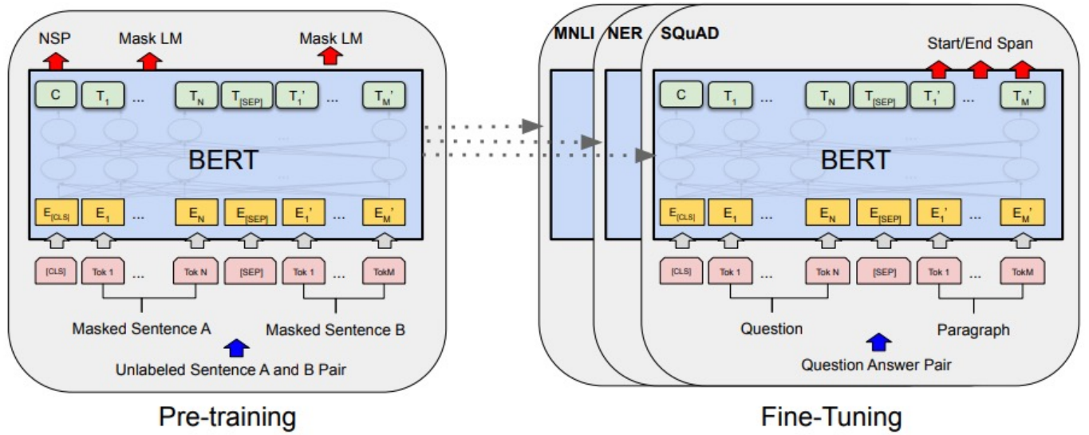
Pre-Train Once, Fine Tune Multiple Times

Slide 17

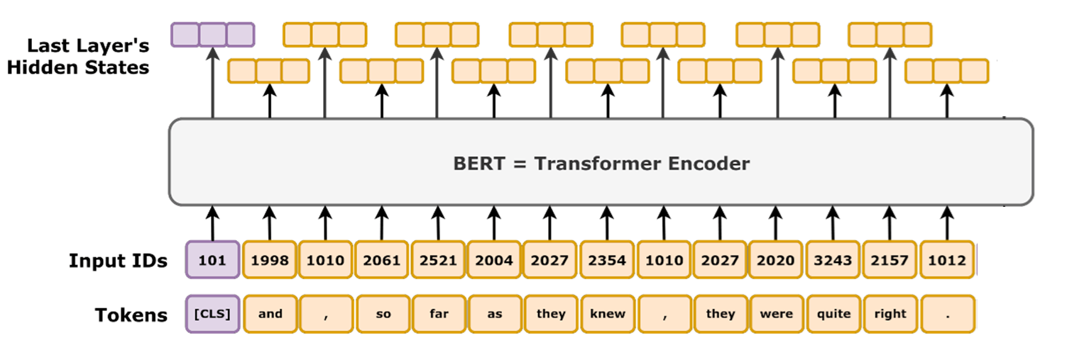
BERT Pretraining: Masked Language Model
iocl
knew
kharagpur
FFNN+Softmax
[MASK]

Slide 18
BERT Pretraining: Masked Language Model
Masked Language Model
80-10-10 Corruption
For 15% of the words:
Replace with [MASK] token (80%)
Heavy rain caused the flood → Heavy [MASK] caused the flood
Replace it with a random word (10%)
Heavy rain caused the flood → Heavy cup caused the flood
Keep it unchanged (10%)
Heavy rain caused the flood → Heavy rain caused the flood

Slide 19
BERT Pretraining: Next Sentence Prediction
Many NLP downstream tasks require understanding the relationship between two sentences (natural language inference, paraphrase detection, QA)
NSP is designed to reduce the gap between pre-training and fine-tuning
Input: [CLS] the man went to the store [SEP] he bought a gallon of milk [SEP]
Label: IsNext
Input: [CLS] the man went to the store [SEP] penguins are flightless birds [SEP]
Label: NotNext

Slide 20
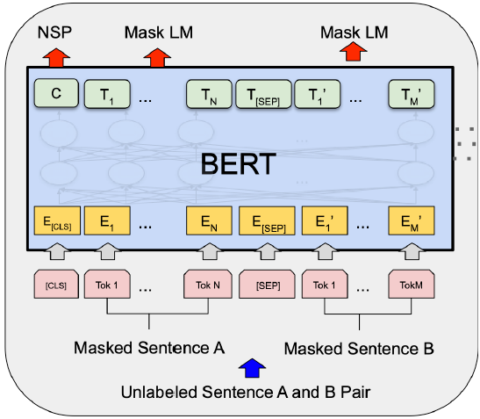
BERT Pretraining
Input: [CLS] the man went to [MASK] store [SEP] he bought a gallon [MASK] milk [SEP]
Label: IsNext
Input: [CLS] the man went [MASK] the store [SEP] penguins are flightless birds [SEP]
Label: NotNext
BERT-base: 12 layers, 768 hidden size, 12 attention heads, 110M parameters
BERT-large: 24 layers, 1024 hidden size, 16 attention heads, 340M parameters
Training corpus: Wikipedia (2.5B) + BooksCorpus (0.8B)
Max sequence size: 512 word pieces (roughly 256 and 256 for two non-contiguous sequences)

Slide 21


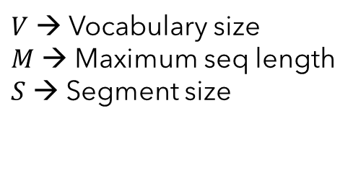








BERT Parameter Count
BERT Base
Encoder Parameters
$$n_{l}=12, d_{m}=768$$
$$V=30000, M=512, S=2$$
$$N_{enc}=n_{l}.12.d_{m}^{2}$$
$N_{enc}=12×12×{768}^{2}≈85$ m
$N_{emb}=\left(30000+512+2\right)×768≈23$ m
$N_{total}=85+23=108$ m
Embedding Parameters
BERT Large
$V$ → Vocabulary size
$M$ → Maximum seq length
$S$ → Segment size
$$n_{l}=24, d_{m}=1024$$
$$V=30000, M=512, S=2$$
$N_{enc}=24×12×{768}^{2}≈302$ m
$$N_{emb}=\left(V+M+S\right)×d_{m}$$
$N_{emb}=\left(30000+512+2\right)×1024≈31$ m
$N_{total}=302+31=333$ m

Slide 22
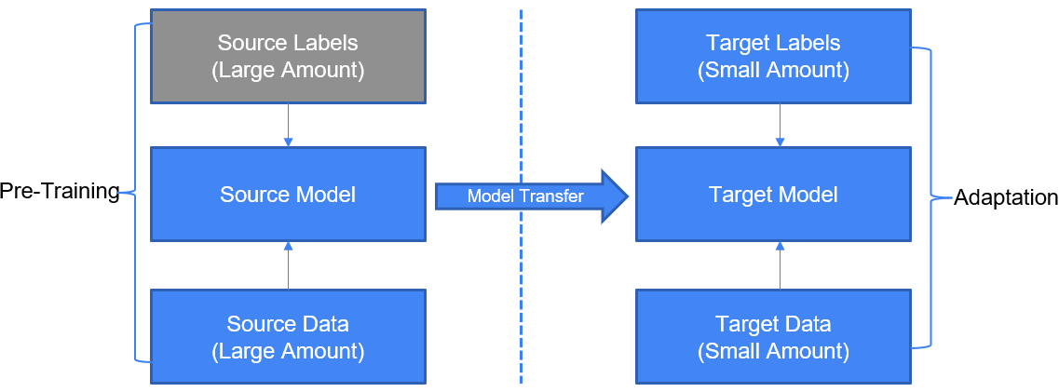
Transfer Learning
Transfer learning: Leverage feature representation from a pre-trained model

Slide 23
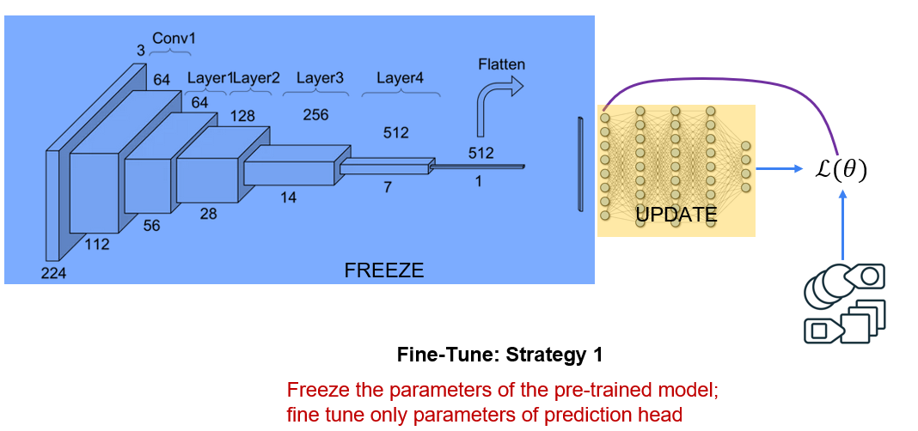
Using Pre-Trained Model

Slide 24
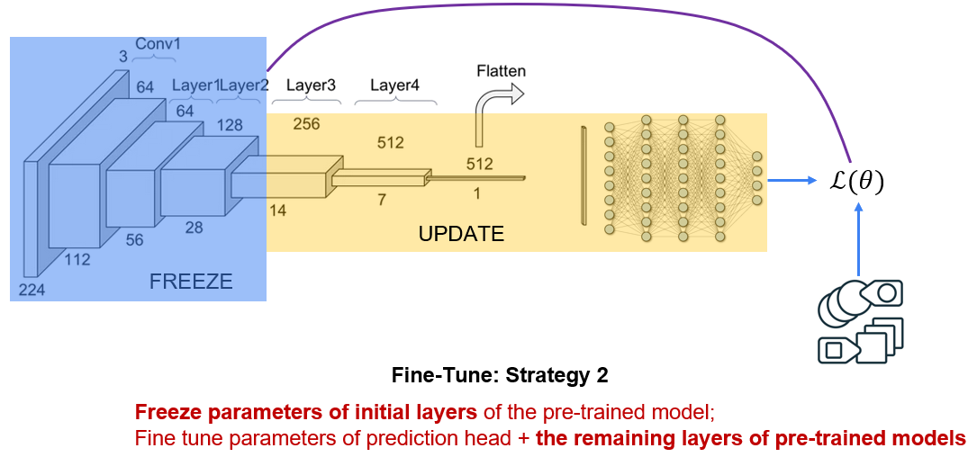
Using Pre-Trained Model

Slide 25
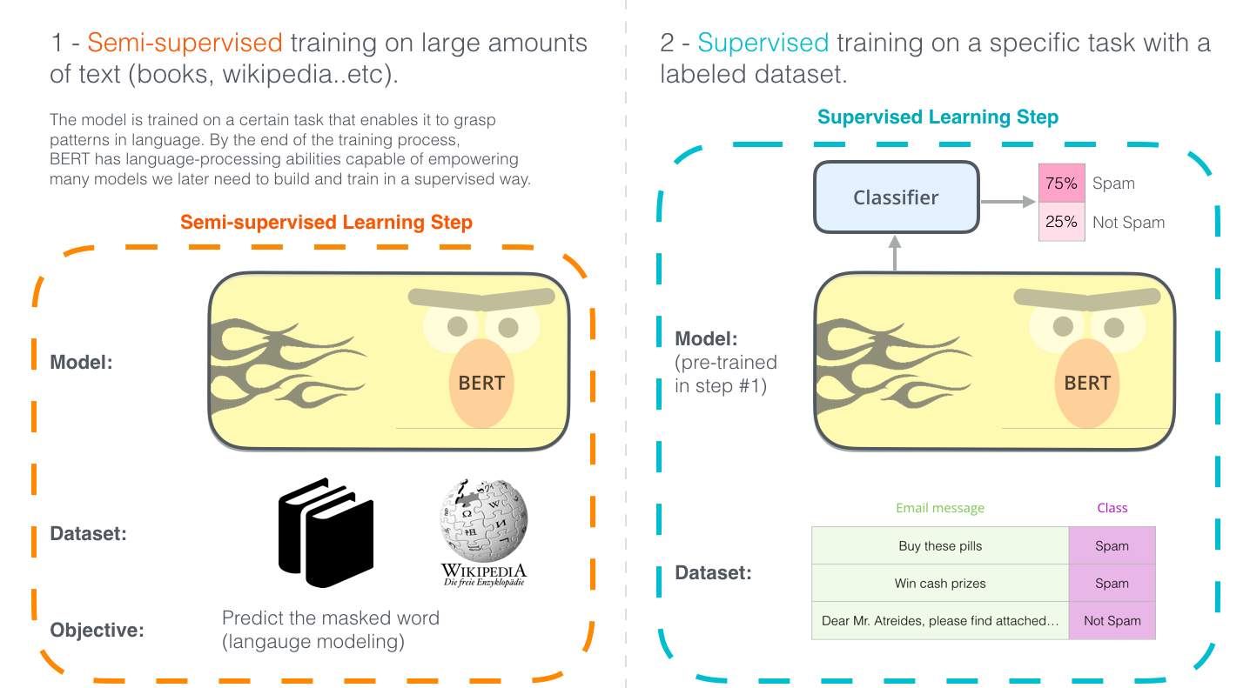
The Case of Transfer Learning in NLP

Slide 26
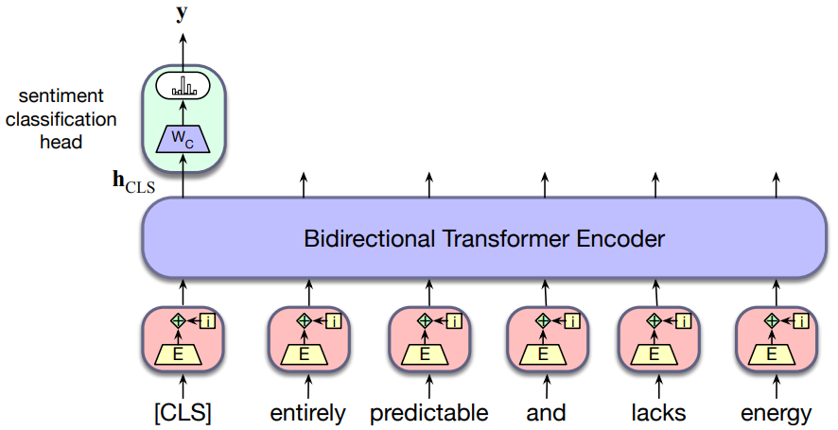
Fine-Tuning: Task Specific Models
Single sentence classification
Tasks: Sentiment analysis (SST-2), Sentence grammaticality (CoLA)

Slide 27
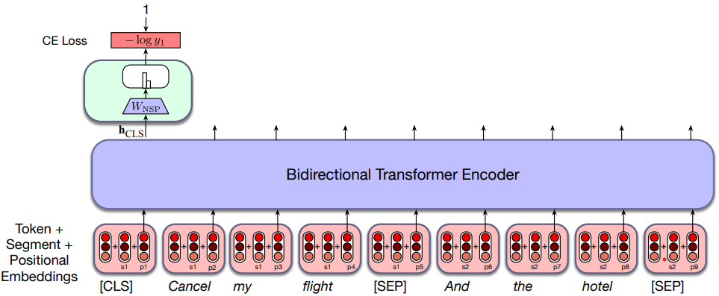
Fine-Tuning: Task Specific Models
Sentence pair classification
Tasks: Natural Language Inference (MNLI, QNLI, RTE)

Slide 28
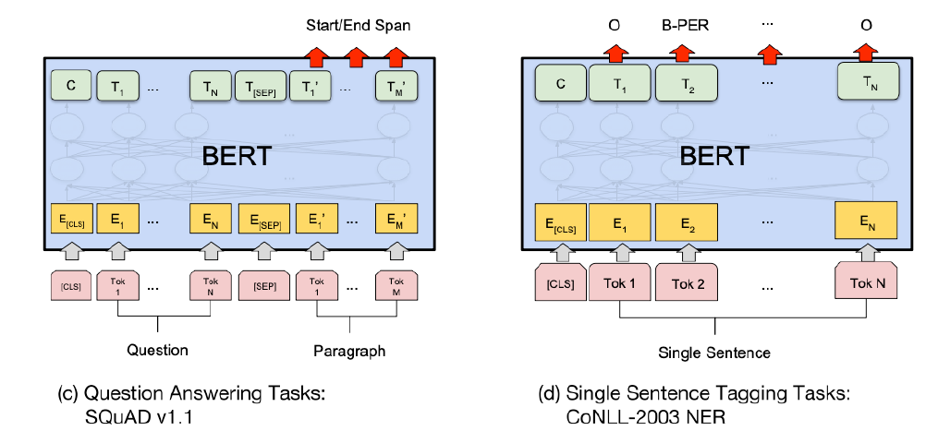
Fine-Tuning: Task Specific Models
Token level classification

Slide 29
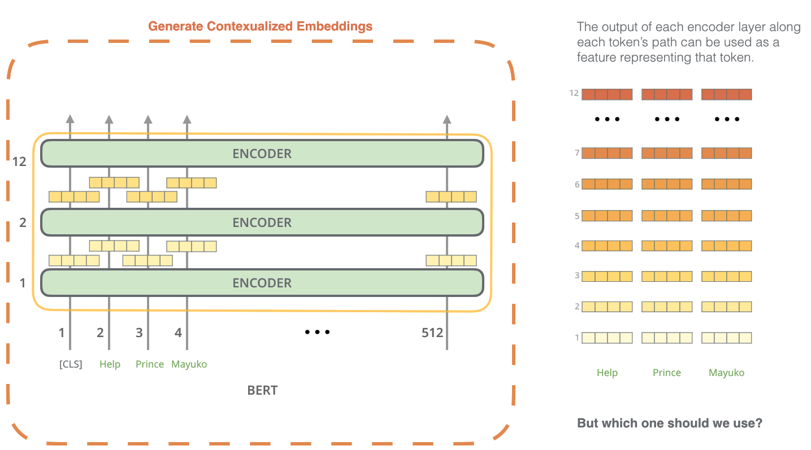
BERT for Feature Extraction

Slide 30
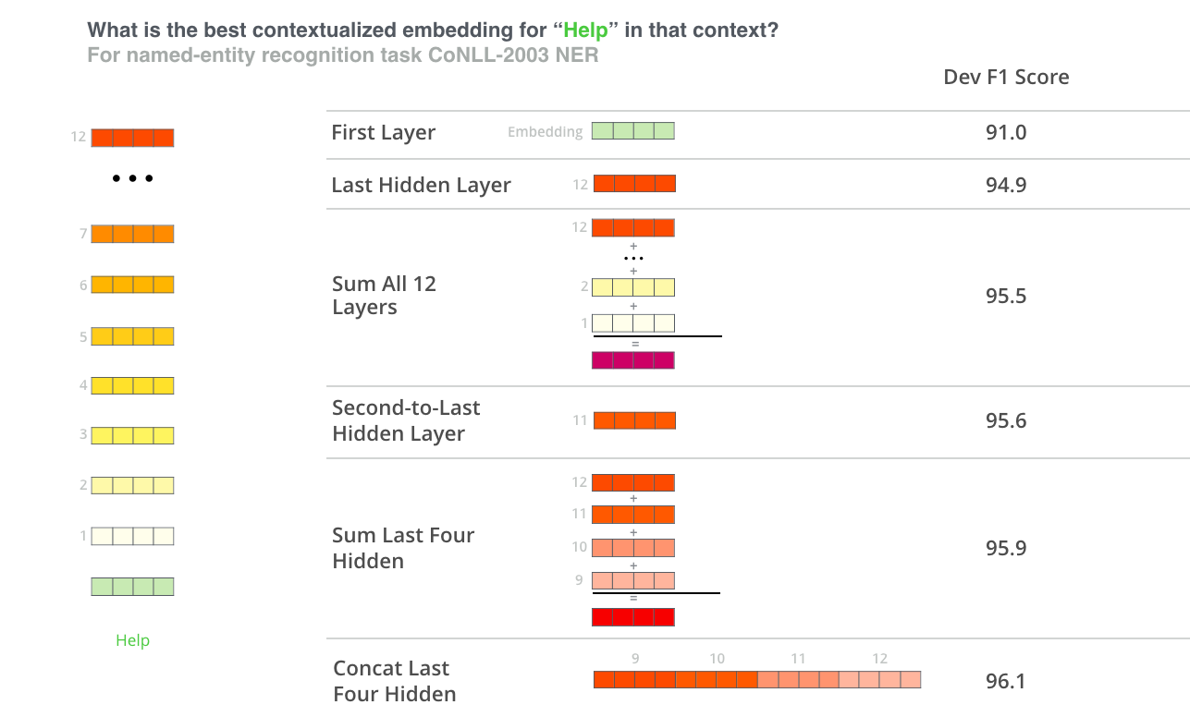
BERT for Feature Extraction

Slide 31
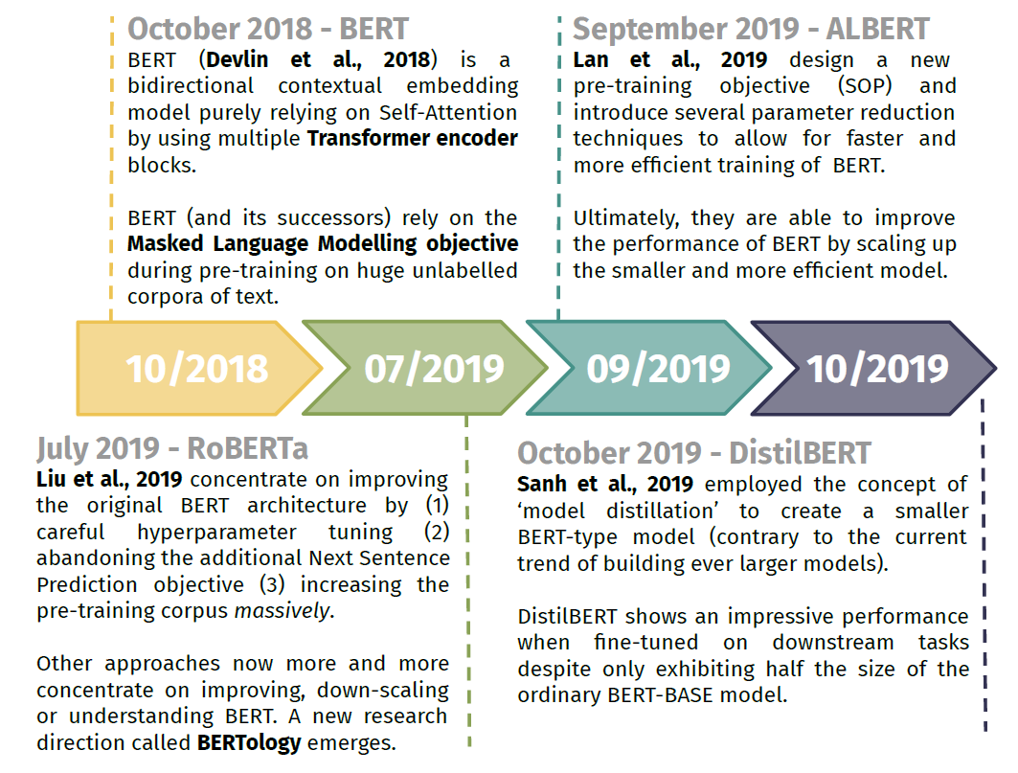
BERT Family & BERTology

Slide 32
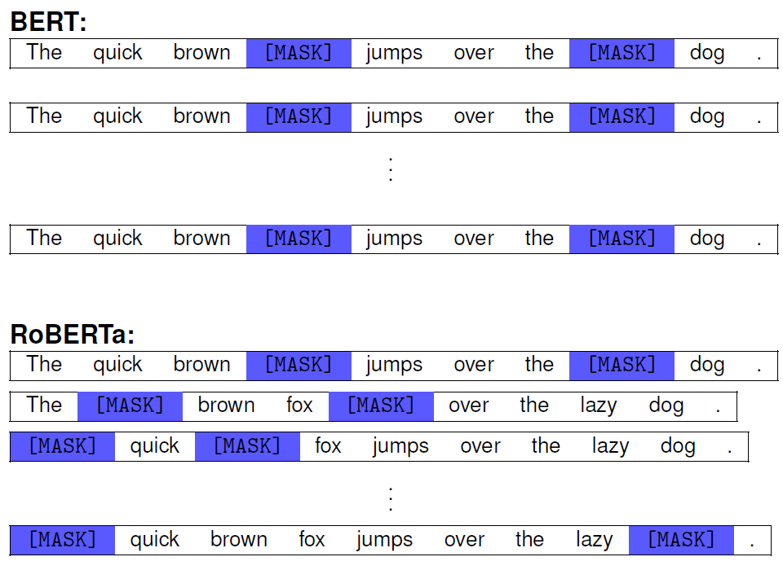
RoBERTa: Dynamic Masking

Slide 33
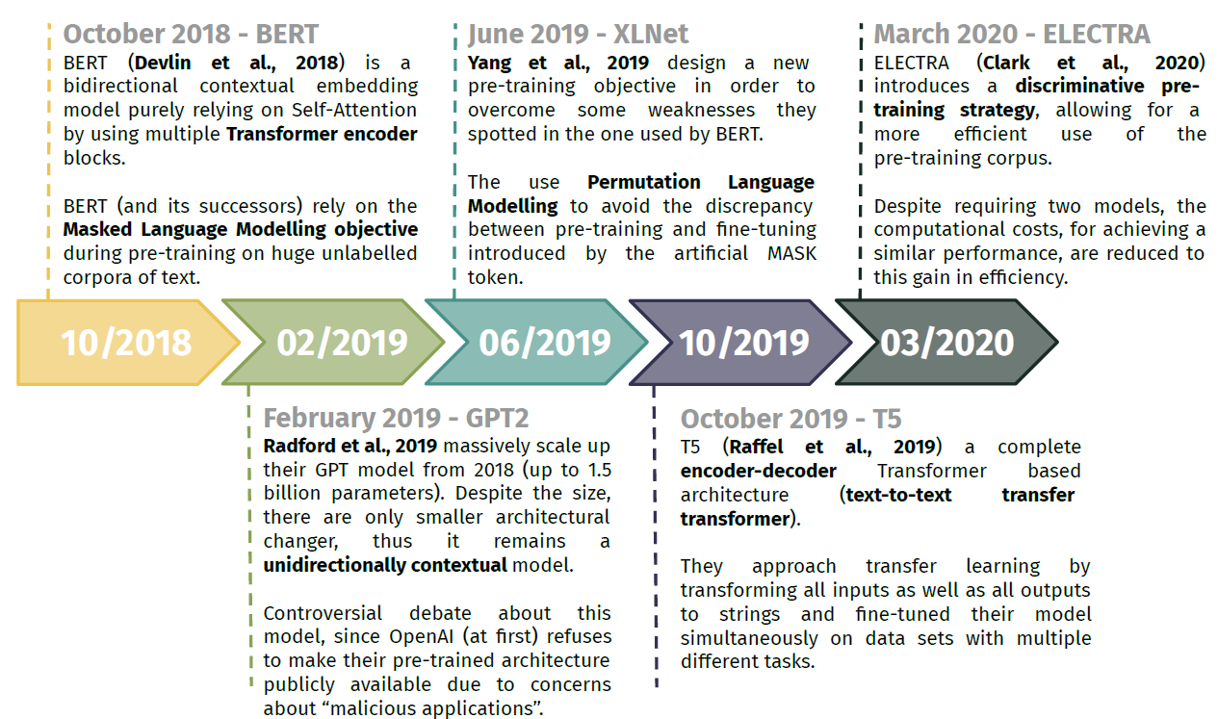
Beyond BERT

Slide 34
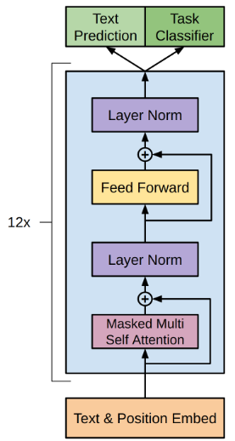
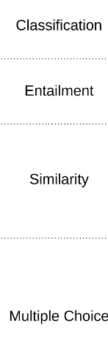
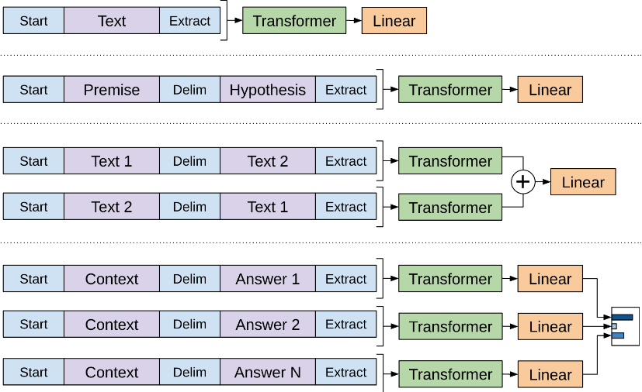
GPT: Auto-Regressive LM
Generative Pre-Trained Transformers
Radford et al., Improving Language Understanding by Generative Pre-Training, 2018

Slide 35

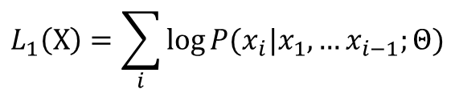








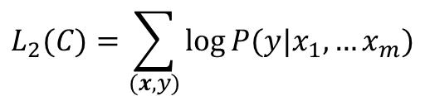
GPT: Auto-Regressive LM
Unsupervised Pre-Training
Supervised Fine-Tuning
Given an unsupervised corpus of tokens
Given a supervised labelled dataset $C$
$$X=\{x_{1}, x_{2},…,x_{n}\}$$
$$C={\left\{{⟨x}_{1}, x_{2},…,x_{m}\right\rangle }_{i};y_{i}\}$$
Maximize AR language model objective
Maximize true label probability
$$L_{1}\left(X\right)=\sum_{i}{\log{P(x_{i}|x_{1}, …x_{i−1};Θ)}}$$
$$P\left(y | x_{1}, …x_{m}\right)=\text{softmax}\text{(}h_{L}^{(m)}W_{f}^{⊤}\text{)}$$
$$L_{2}(C)=\sum_{(x,y)}{\log{P(y|x_{1}, …x_{m})}}$$
Decoder Block
$$h_{0}=UW_{e}$$
Fine tuning requires only $W_{f}$ parameters
$h_{l}=$ Transformer-Block($h_{l−1}$) $∀l∈[1,L]$
$P(x_{t})=$ softmax($h_{L}^{(<t)}W_{o}^{⊤}$)
Maximize true label probability and token prob
$$L_{3}\left(C\right)=L_{2}\left(C\right)+λ∗L_{1}(C)$$

Slide 36

GPT-2: Parameter Count
Configuration
$n_{l}=12, d_{m}=768, V=40000, M=512$
Decoder Parameters: $12. d_{m}^{2}$
Why not $16. d_{m}^{2}$?
Total no of parameters
$n_{l}.12.d_{m}^{2}+\left(V+M\right)×768$
117 M

Slide 37
Transformer-XL
Transformer addresses the problem of long range dependency as present in recurrent architectures like RNN, LSTM
Transformers enables parallelization as compared to linear dependency
But fixed context length is an issue
Context fragmentation: The context is broken into fragments with a hard context length
First few symbols of a fragment always have less amount of context
Da et al., Transformer-XL: Attentive Language Models Beyond a Fixed-Length Context, 2019

Slide 38
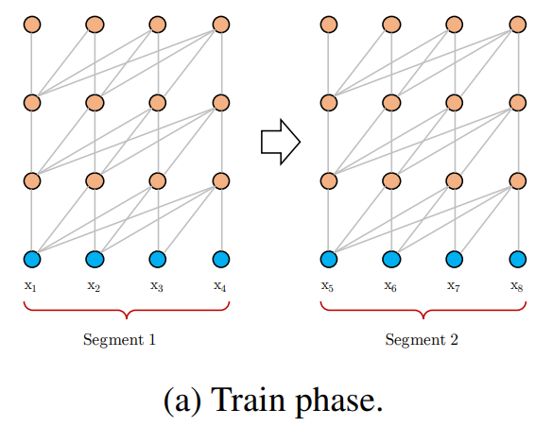
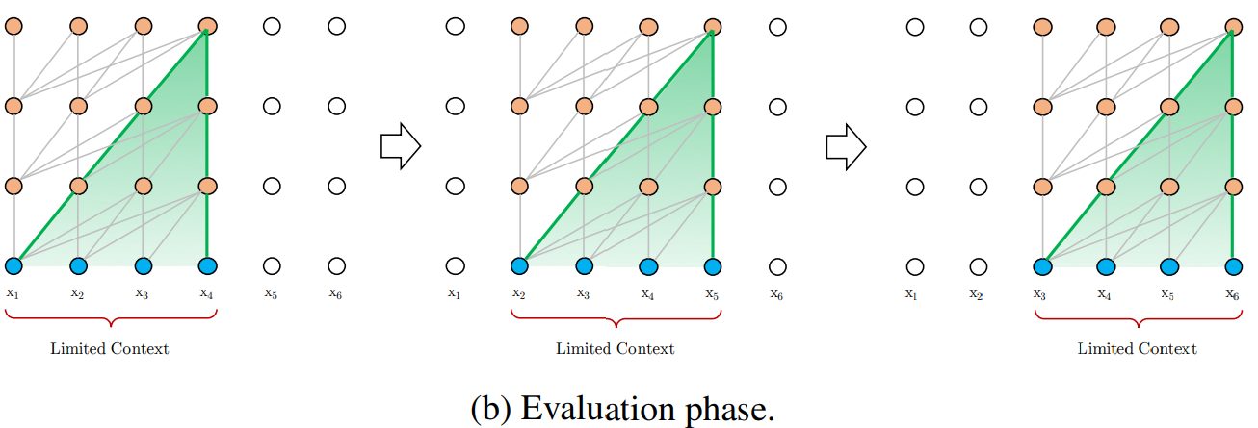
Transformer-XL: Context Fragmentation

Slide 39
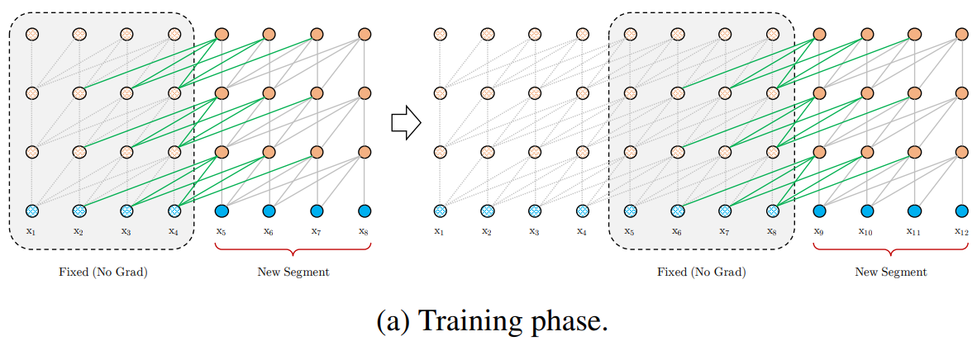
Transformer-XL: Add Recurrence
Segment-Level Recurrence with State Reuse
Hidden state sequence computed for the previous segment is fixed and cached
Reused as an extended context when the model processes the next new segment

Slide 40
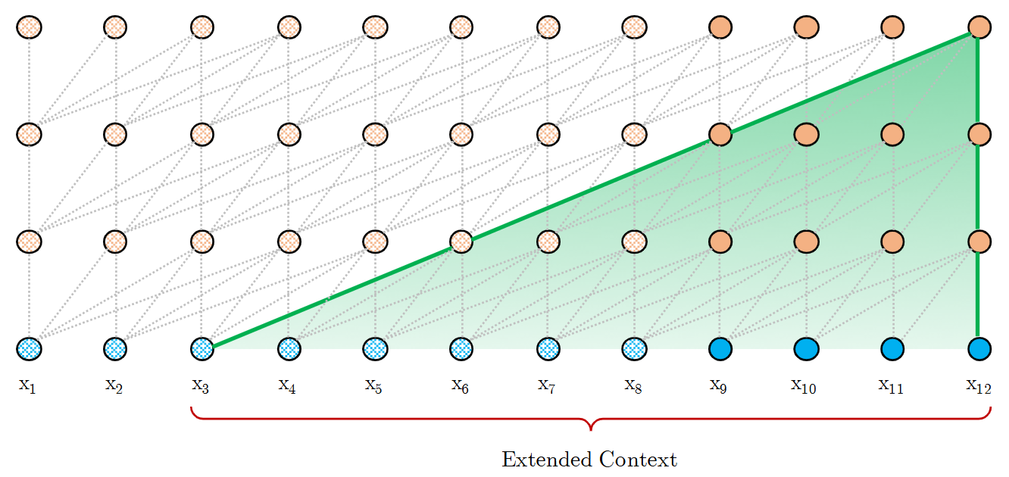
Transformer-XL: Add Recurrence
Inference Phase
Code explanation: https://www.youtube.com/watch?v=YZ1XJEJUyGI

Slide 41
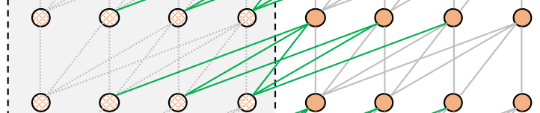

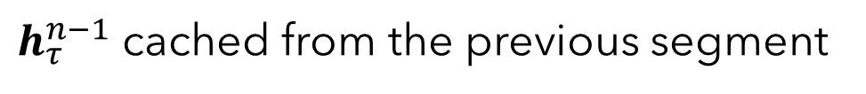
Transformer-XL: Add Recurrence
Two consecutive segments: $s_{τ}=[x_{τ,1}, ….x_{τ,L}]{ s}_{τ+1}=[x_{τ+1,1}, ….x_{τ+1,L}]$
Hidden state representation $n^{th}$ layer: $h_{τ}^{n}∈ℝ^{L×d}, d$ is the hidden dimension
SG → Stop Gradient
The key $k_{τ+1}^{n}$ and value $v_{τ+1}^{n}$ are conditioned on extended context ${\tilde{h}}_{τ+1}^{n−1}$
$h_{τ}^{n−1}$ cached from the previous segment

Slide 42
XLNet
Autoregressive Language Model
Denoising Autoencoder (BERT)
York is a city [EOS]
York is
Unidirectional Transformer
Bidirectional Transformer
New York is a city
New [MASK] [MASK] a city
Full autoregressive dependence
Independent predictions (language is sequential)
Free from artificial noise
Artificial noise (pretrain-finetune discrepancy)
No bidirectional context
Natural bidirectional context
Yang et al., XLNet: Generalized Autoregressive Pretraining for Language Understanding, 2019

Slide 43
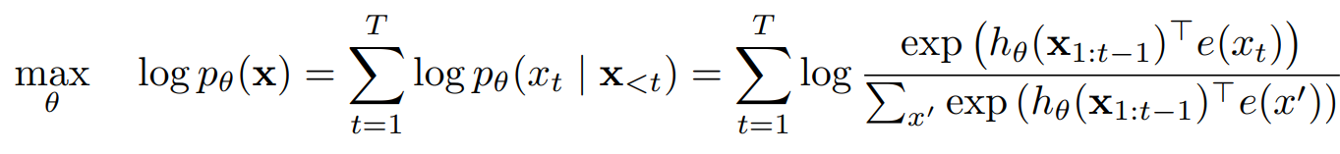
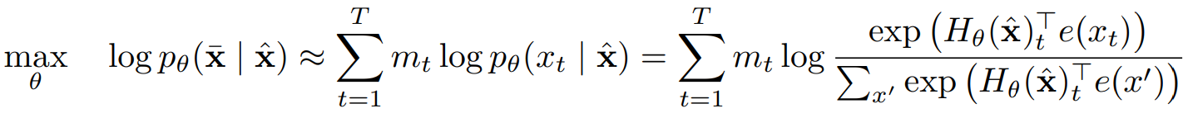
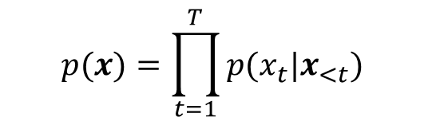

XLNet: AR vs AE Objectives
Given a text sequence: $x=[x_{1}, x_{2}, …, x_{T}]$
ARLM pretraining objective: Maximize likelihood under the forward autoregressive factorization
$$p(x)=\prod_{t=1}^{T}{p(x_{t}|x_{<t})}$$
AELM pretraining objective: Reconstruct masked tokens ($\overline{x}$) from corrupted seq ($\hat{x}$)
Can we have the benefit of bidirectionality in an autoregressive model?

Slide 44

XLNet: Issue with AE (BERT)
BERT predicts [MASK] → boat using context
A boat can be beached, or
A boat is often found on a riverside, but
BERT does not necessarily learn an association between boat and beached as riverside can be used to predict boat to replace [MASK]
BERT predicts the masked tokens independently
Does not consider interaction between the predicted tokens
Consider: The [MASK] was [MASK] on the riverside
BERT assigns high probabilities to: (boat, beached) and (parade, seen)
But, BERT might assign high probability to (parade, beached) also
The [MASK] was beached on the riverside
https://rbcborealis.com/research-blogs/understanding-xlnet/

Slide 45


XLNet: Improvise Bidirectionality
Improvisation: Predict each token in a sequence conditioned on different
combinations of other tokens in the sequence
The[1] _______ [2] was[3] beached[4] on[5] the[6] riverside[7]
P(boat|was on riverside)
P(boat|was beached)
P([2]| [3], [5], [7])
P([2]| [3], [4])
Factorization over permutation of sequence index

Slide 46

XLNet: Permutation Language Model
What if an autoregressive transformer is pretrained with
all the permutations of input sequence?
For a sequence of length $T,$there are $T!$ different orders
Each order can be used to perform a valid AR factorization
The model will learn to gather information from all the positions
on both sides

Slide 47






XLNet: Permutation Language Model
AR factorization: $P(x_{t}|x_{<t})$
Reverse AR factorization: $P(x_{t}|x_{>t})$
$$[1, 2, …, T]$$
$$[T, …, 2, 1]$$
Two permutations
Two nearest tokens: $P(x_{t}|x_{t−1},x_{t+1})$
Arbitrary: $P(x_{t}|x_{t−1},x_{t+2}, x_{t−3})$
Love[1] conquers[2] all[3] things[4]
[1,2,3,4]
[3,4,2,1]
[4,2,1,3]
P(conquers| love)
P(things| all)
P(conquers| things)
P([2]| [1])
P(conquers| all, things)
P(love| things, conquers)
P(all| love, conquers)
P(love| all, things, conquers)
P(all| things, conquers, love)
P([3]| [1][2])
P(things| love, conquers, all)
P([4]| [1][2][3])

Slide 48









XLNet: Permutation Language Model
set of all possible permutations of the length-T index sequence
($1,2,…, T$)
$t^{th}$ element of a permutation
First $t−1$ elements of
Parameters shared across all the factorization order

Slide 49
XLNet: The Architectural Innovations
Permutation: only on factorization order, not on sequence
Attention Mask: To ensure AR factorization on permutation order
Two Steam Self-Attention: To allow prediction to be aware of the target position maintaining causality
Partial Prediction: Only predict a subset of token in each permutation

Slide 50

XLNet: Permutation
Standard factorization order: 1→2→3→4
$$P\left(x\right)=P\left(x_{1}\right)P\left(x_{2} | x_{1}\right)P\left(x_{3} | x_{1}, x_{2}\right)P(x_{4}|x_{1}, x_{2}, x_{3})$$

Slide 51

XLNet: Permutation
Permuted factorization order: 4→1→3→2
$$P\left(x\right)=P\left(x_{4}\right)P\left(x_{1} | x_{4}\right)P\left(x_{3} | x_{1}, x_{4}\right)P(x_{2}|x_{1}, x_{4}, x_{3})$$

Slide 52

XLNet: Permutation

Slide 53


XLNet: Permutation

Slide 54

XLNet: Permutation

Slide 55

XLNet: Permutation

Slide 56


XLNet: Attention Mask
How does the model know about word order?
Love conquers all things
$$P(all|conquers)$$
$$P(all|love)$$
Permutation factorization order makes all tokens equally likely to be next to each other
We want the model to predict $P(all|conquers, 2)$ and $P(all|love, 1)$
The token order is kept the same only index is permuted
Valid context tokens for a given factorization is dictated by an attention mask.

Slide 57
XLNet: Attention Mask
Love[1] conquers[2] all[3] things[4]
Consider a permutation order 3→1→2→4
First element in the order (3rd token) does not have
any context
The second element (1st token) has 3rd token as context
The third element (2nd token) has 3rd and 1st tokens
The fourth element (4th token) as 3rd, 1st and 2nd tokens
0 | 0 | 1 | 0
1 | 0 | 1 | 0
0 | 0 | 0 | 0
1 | 1 | 1 | 0

Slide 58








XLNet: Standard LM Parameterization
two[1] positions[2] should[3] certainly[4] be[5] different[6]
$$z^{(1)}=[4,3,5,6,2,1]$$
$$z^{(2)}=[4,3,5,2,1,6]$$
$${z_{<4}^{(1)}=z_{<4}^{(2)}=z}_{<4}=[4,3,5]$$
In general,
$${z_{<t}^{(1)}=z_{<t}^{(2)}=z}_{<t}$$
$$z_{t}^{(1)}=i;z_{t}^{(2)}=j$$
and
$$i≠j$$
Two different target positions $i$ and $j$share exactly the same model prediction

Slide 59




XLNet: Reparameterization
Reparameterization
of target-aware representations removes the
ambiguity in target prediction
$$x_{z_{<t}}$$
$$z_{t}$$

Slide 60





XLNet: Reparameterization
attention
$$x_{z_{<t}}$$
$$z_{t}$$
Two requirements:
To predict $x_{z_{t}}, g_{θ}(x_{z_{<t}},z_{t})$ should only use position $z_{t}$ but not $x_{z_{t}}$
To predict tokens $x_{z_{j}}$ with $j>t,g_{θ}(x_{z_{<t}},z_{t})$ should also encode the
content $x_{z_{t}}$
Should not use $x_{z_{t}}$
Should use $x_{z_{t}}$
How to resolve such a contradiction?

Slide 61





XLNet: Two-Stream Architecture
Content Representation: Encodes both the context and $x_{z_{t}}$ itself
$h_{θ}(x_{z≤t})$ or $h_{z_{t}}$
Query Representation: has access to the contextual information $x_{z<t}$ and $z_{t}$
$g_{θ}(x_{z<t}, z_{t})$ or $g_{z_{t}}$
$$g_{i}^{(0)}=w$$
$$h_{i}^{(0)}=e(x_{i})$$
Self-Attention Layers: $m=1, 2, …, M$

Slide 62


XLNet: Two-Stream Architecture
Content Stream
Query Stream

Slide 63

XLNet: Two-Stream Architecture

Slide 64



XLNet: Partial Prediction
For a single sequence, the model is trained with multiple
permutation orderings (worst case O(T!))
Slow convergence
Consider last few tokens in the factorization order as prediction target
$$x_{z_{≤c}}$$
$$x_{z_{>c}}$$
For unselected tokens, their query representations need not be computed, which saves speed and memory

Slide 65

XLNet: Integrating Transformer-XL
Previous segment state
is independent of the
current factorization order

Slide 66





XLNet: Integrating Transformer-XL
Cached embeddings from prev segment

Slide 67
Text-to-Text Tasks
BERT is differently fine-tuned for each task
Need a different model for each task
Not realistic in real deployment scenario
Human Learning
Probably a single model that solves all tasks
Is there a framework to create a single model that solves all tasks?

Slide 68
Text-to-Text Tasks
BERT follows Pre-Training followed by fine tuning
Fine tuning requires annotated data for supervision
Human, in general, do not learn from labelled examples
Human rely on task descriptions along with possibly some examples
Is there a framework that allows us to leverage task descriptions?

Slide 69
Text-to-Text Tasks
BERT requires relatively good amount of data for fine tuning
But human may require a very small number of examples (2-3)
Is there a framework that allows us to learn from just a small number of examples?
Few Shot Learning

Slide 70

Text-to-Text Task
Input: Text in source language
Output: Text in target language

Slide 71

Text-to-Text Task

Slide 72
Text-to-Text Task
How does BERT know which task it is performing?
It doesn’t
BERT just learns associations between text features and class distributions
BERT does not “understand“ what task it is actually performing
Different BERT model for different tasks
Raffel et al., Exploring the Limits of Transfer Learning with a Unified Text-to-Text Transformer, 2019

Slide 73


Text-to-Text Task
How could we “inform“ our model about the task?
Describe the task in natural language
Learn to associate:
task descriptions to a set of class names
text features to class name distributions

Slide 74

Text-to-Text Task
If the model can learn to link task descriptions to label sets, can it learn to perform multiple tasks at once?
Through fine tuning each task description will be linked to its label set

Slide 75


Text-to-Text Task
Can we have one single model for both different classification tasks and generation tasks?
Yes, we just have to design suitable task descriptions

Slide 76

Text-to-Text Transfer Transformer (T5)
Sequential Transfer Learning vs Multi-Task Transfer Learning
General Framework: “text-to-text” problem
Unified different Transfer Learning approaches in NLP
Same model, objective, training procedure, and decoding process to every task

Slide 77

T5: Different Architectural Options

Slide 78

T5: Different Architectural Options

Slide 79

T5: Unsupervised Training Objectives

Slide 80



MASS-Style Pre-training
The model only predicts the masked fragment $x_{3}x_{4}x_{5}x_{6}$, given $x_{3}x_{4}x_{5}$ as the decoder input for position 4 − 6
Decoder takes the special mask symbol [M] as inputs for the other positions
Song et al., MASS: Masked Sequence to Sequence Pre-training for Language Generation

Slide 81



MASS-Style Pre-training

Slide 82

T5: Unsupervised Training Objectives

Slide 83
T5: Unsupervised Training Objectives
The target sequences are shorter and consequently make training faster

Slide 84

T5: Unsupervised Training Objectives

Slide 85


T5: Translating Task into Text-to-Text

Slide 86
T5: How to Mix Pretraining Datasets?
Should not overtrain or undertrain the models
Should see enough data to perform task well
But not large to memorize the training data
Dataset proportion → “difficulty” of the task
Task interference or negative transfer
Achieving good performance on one task can hinder performance on another

Slide 87


T5: Dataset Mixing Strategies
Examples-proportional mixing
Decide the mixing proportion based on the size of the dataset
Concatenating all the datasets and randomly sampling examples
Vast majority of the training data is unlabelled
Supervised training data will be sampled with very low probability
Artificial limit on the dataset size ($K$)
Probability of sampling an example from $m^{th}$ task
$$r_{m}=\frac{min⁡(e_{m},K)}{\sum{\min{(e_{n},K)}}}$$
Notes:
e_m is the dataset size of the mth task and e_n is the dataset size of the nth task

Slide 88

T5: Dataset Mixing Strategies
Equal Mixing
Sample examples from each task with equal probability
Suboptimal
Quickly overfit on low-resource tasks and underfit on high-resource tasks
Temperature scaled mixing
Control trade-off between disproportionate vs equal mixing
Adjust temperature to control the mixing rate
$$r_{m}^{′}=\frac{r_{m}^{1/T} }{\sum{r_{n}^{1/T} }}$$

Slide 89

T5: In a Nutshell
Training Objective:
iid denoising objective with span corruption
Mean span length = 3 and corruption proportion = 15%
Longer Training:
Substantially longer pre-training without repeating data
C4 is large enough (no repetition even after $2^{23}$ training steps)
1 million steps, batch size = $2^{11}$ sequences of length = 512
Model size:
Base – 220M, Small – 60M, Large – 770M, Very Large – 3B and 11B

Slide 90
T5: In a Nutshell
Multi-Task pre-Training:
pre-training on a multi-task mixture of unsupervised and supervised tasks
Artificial limit on dataset size
Fine Tuning
Individual GLUE and SuperGLUE tasks
Concatenate all the benchmarks
Fine tune the model only once
Mitigate the overfitting problem for low-resourced tasks
Smaller batch size (batch size of 8 length-512 sequences) to avoid repetition for the low-resourced tasks

Slide 91
T5: In a Nutshell
Beam Search:
Greedy decoding may not be always “optimal” and may not model diversity
Consider different possibilities (limited by bandwidth) may allow diverse sequence generation.
Test set:

